Slide 1
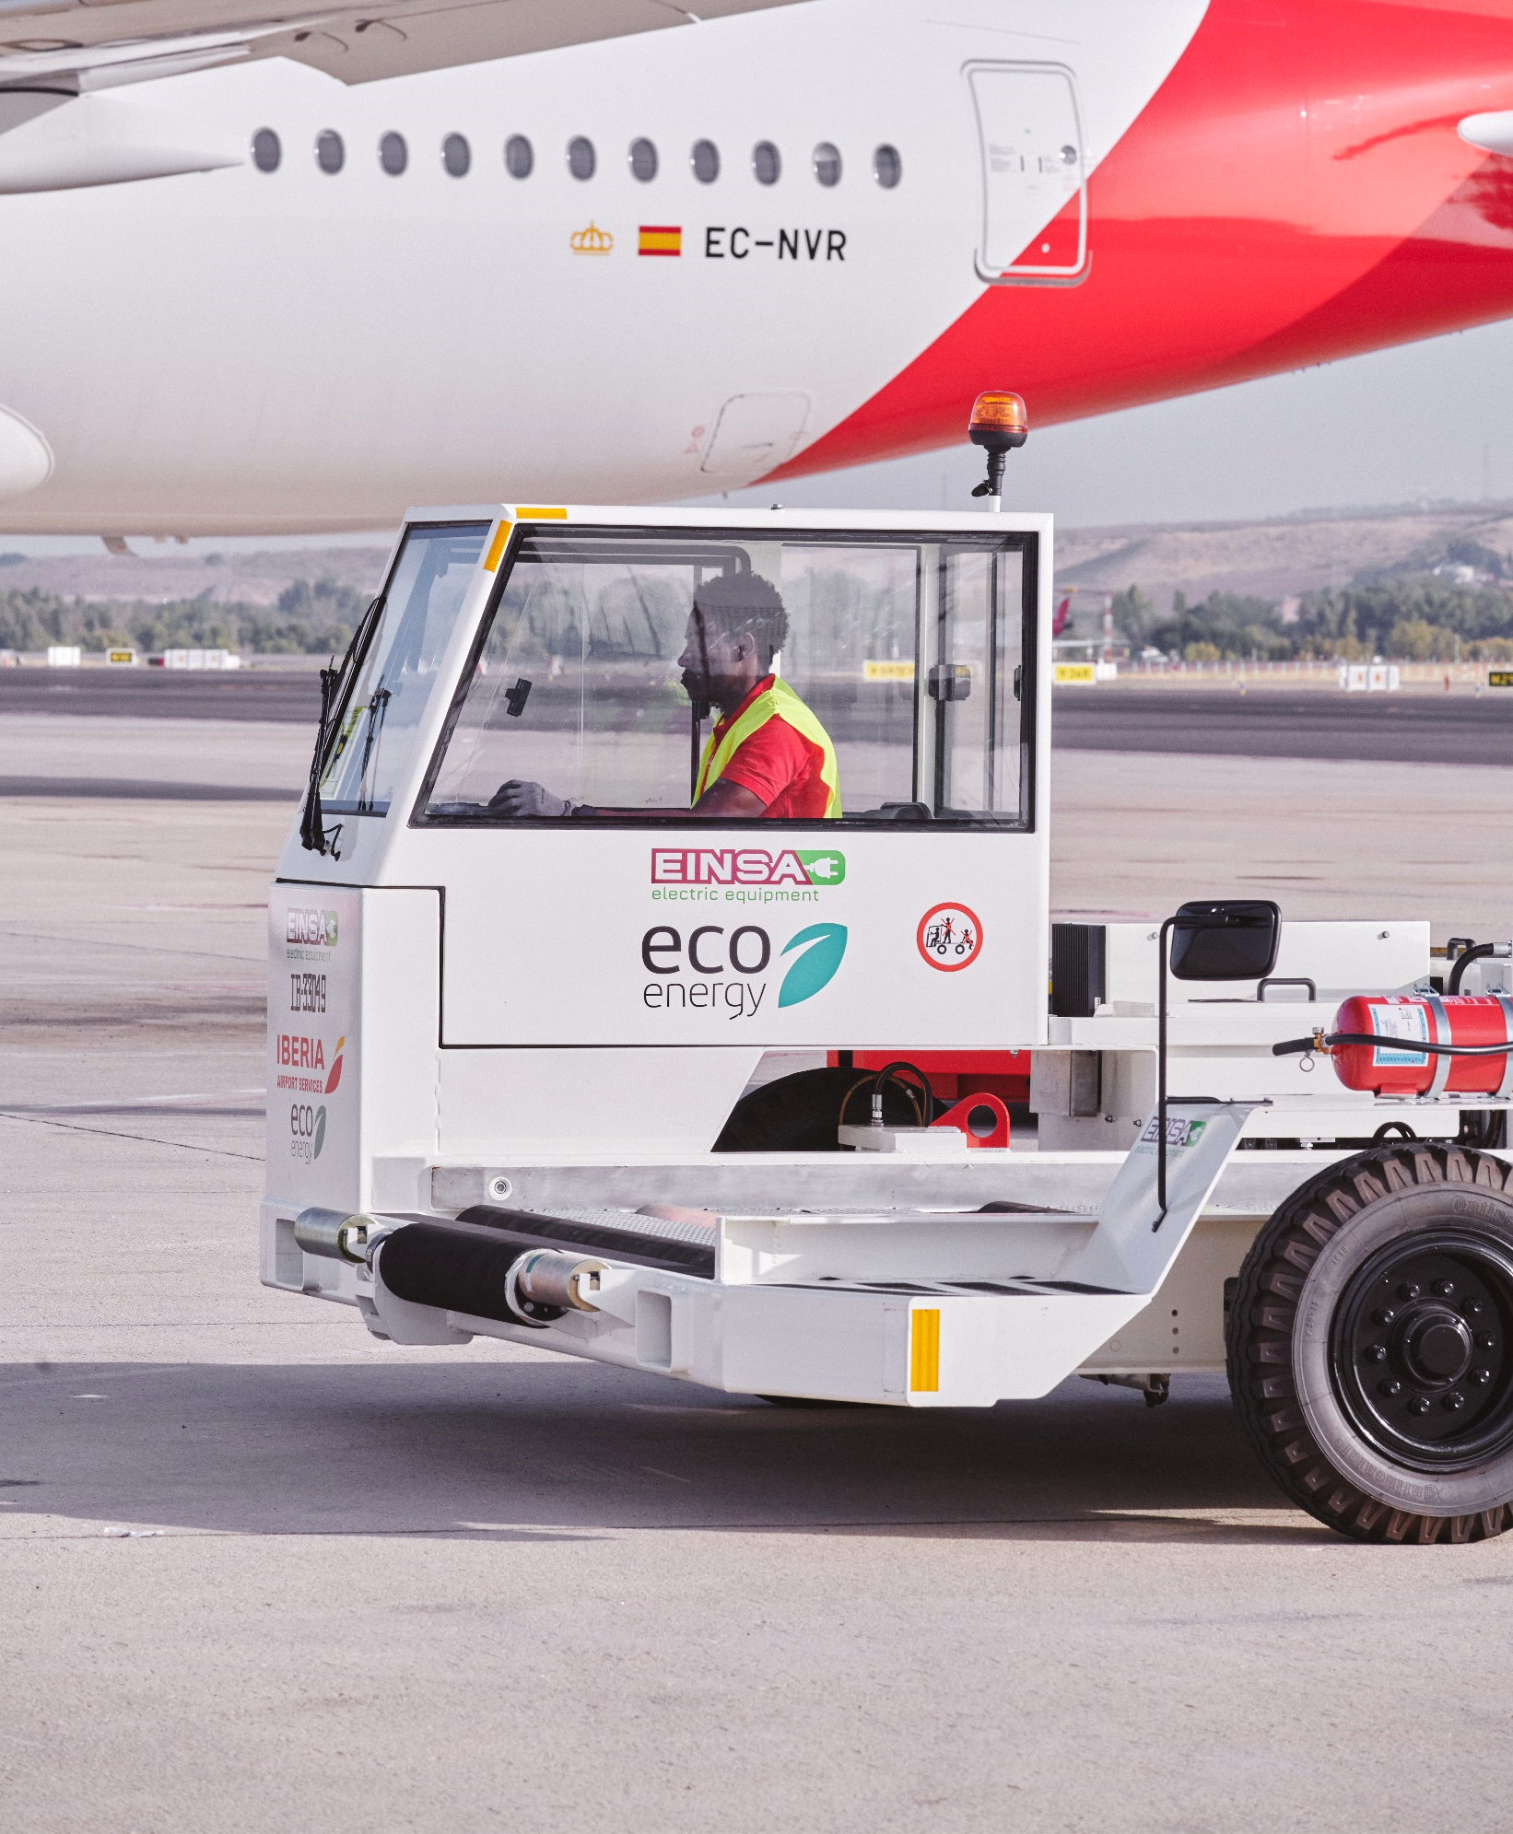
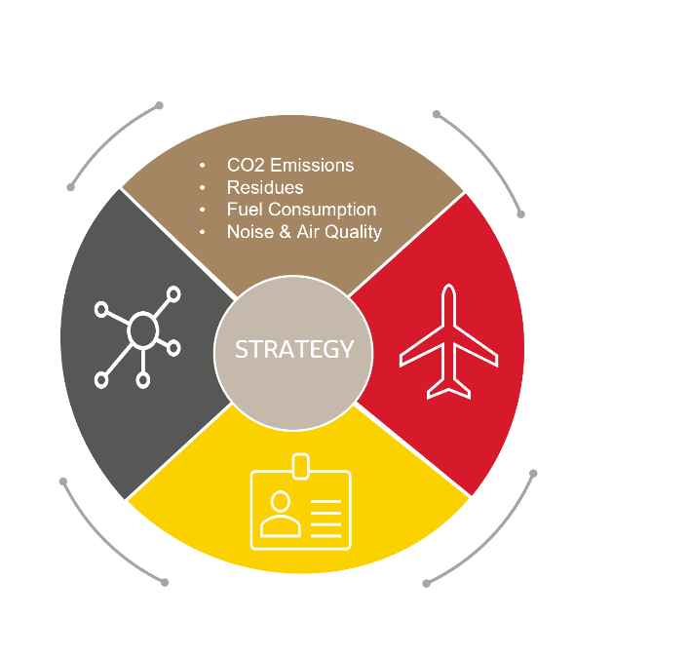
Sustainability plan
2023 – 2030
Objetive: zero emission
Committed to achieve our Zero Carbon target by 2025, we have developed a sustainability policy that aims to minimise environmental and social impact, as well as raising awareness among all employees and collaborators.
Our Sustainability Plan includes 30 initiatives and collaboration agreements already established with more than 50 companies, including Repsol Cepsa, eEalux, Enagas, Envera and Make a wish, among others, to successfully develop our Sustainability Plan.
1. IBERIA AIRPORT SERVICES. Sustainability plan 2023 – 2030

Slide 2
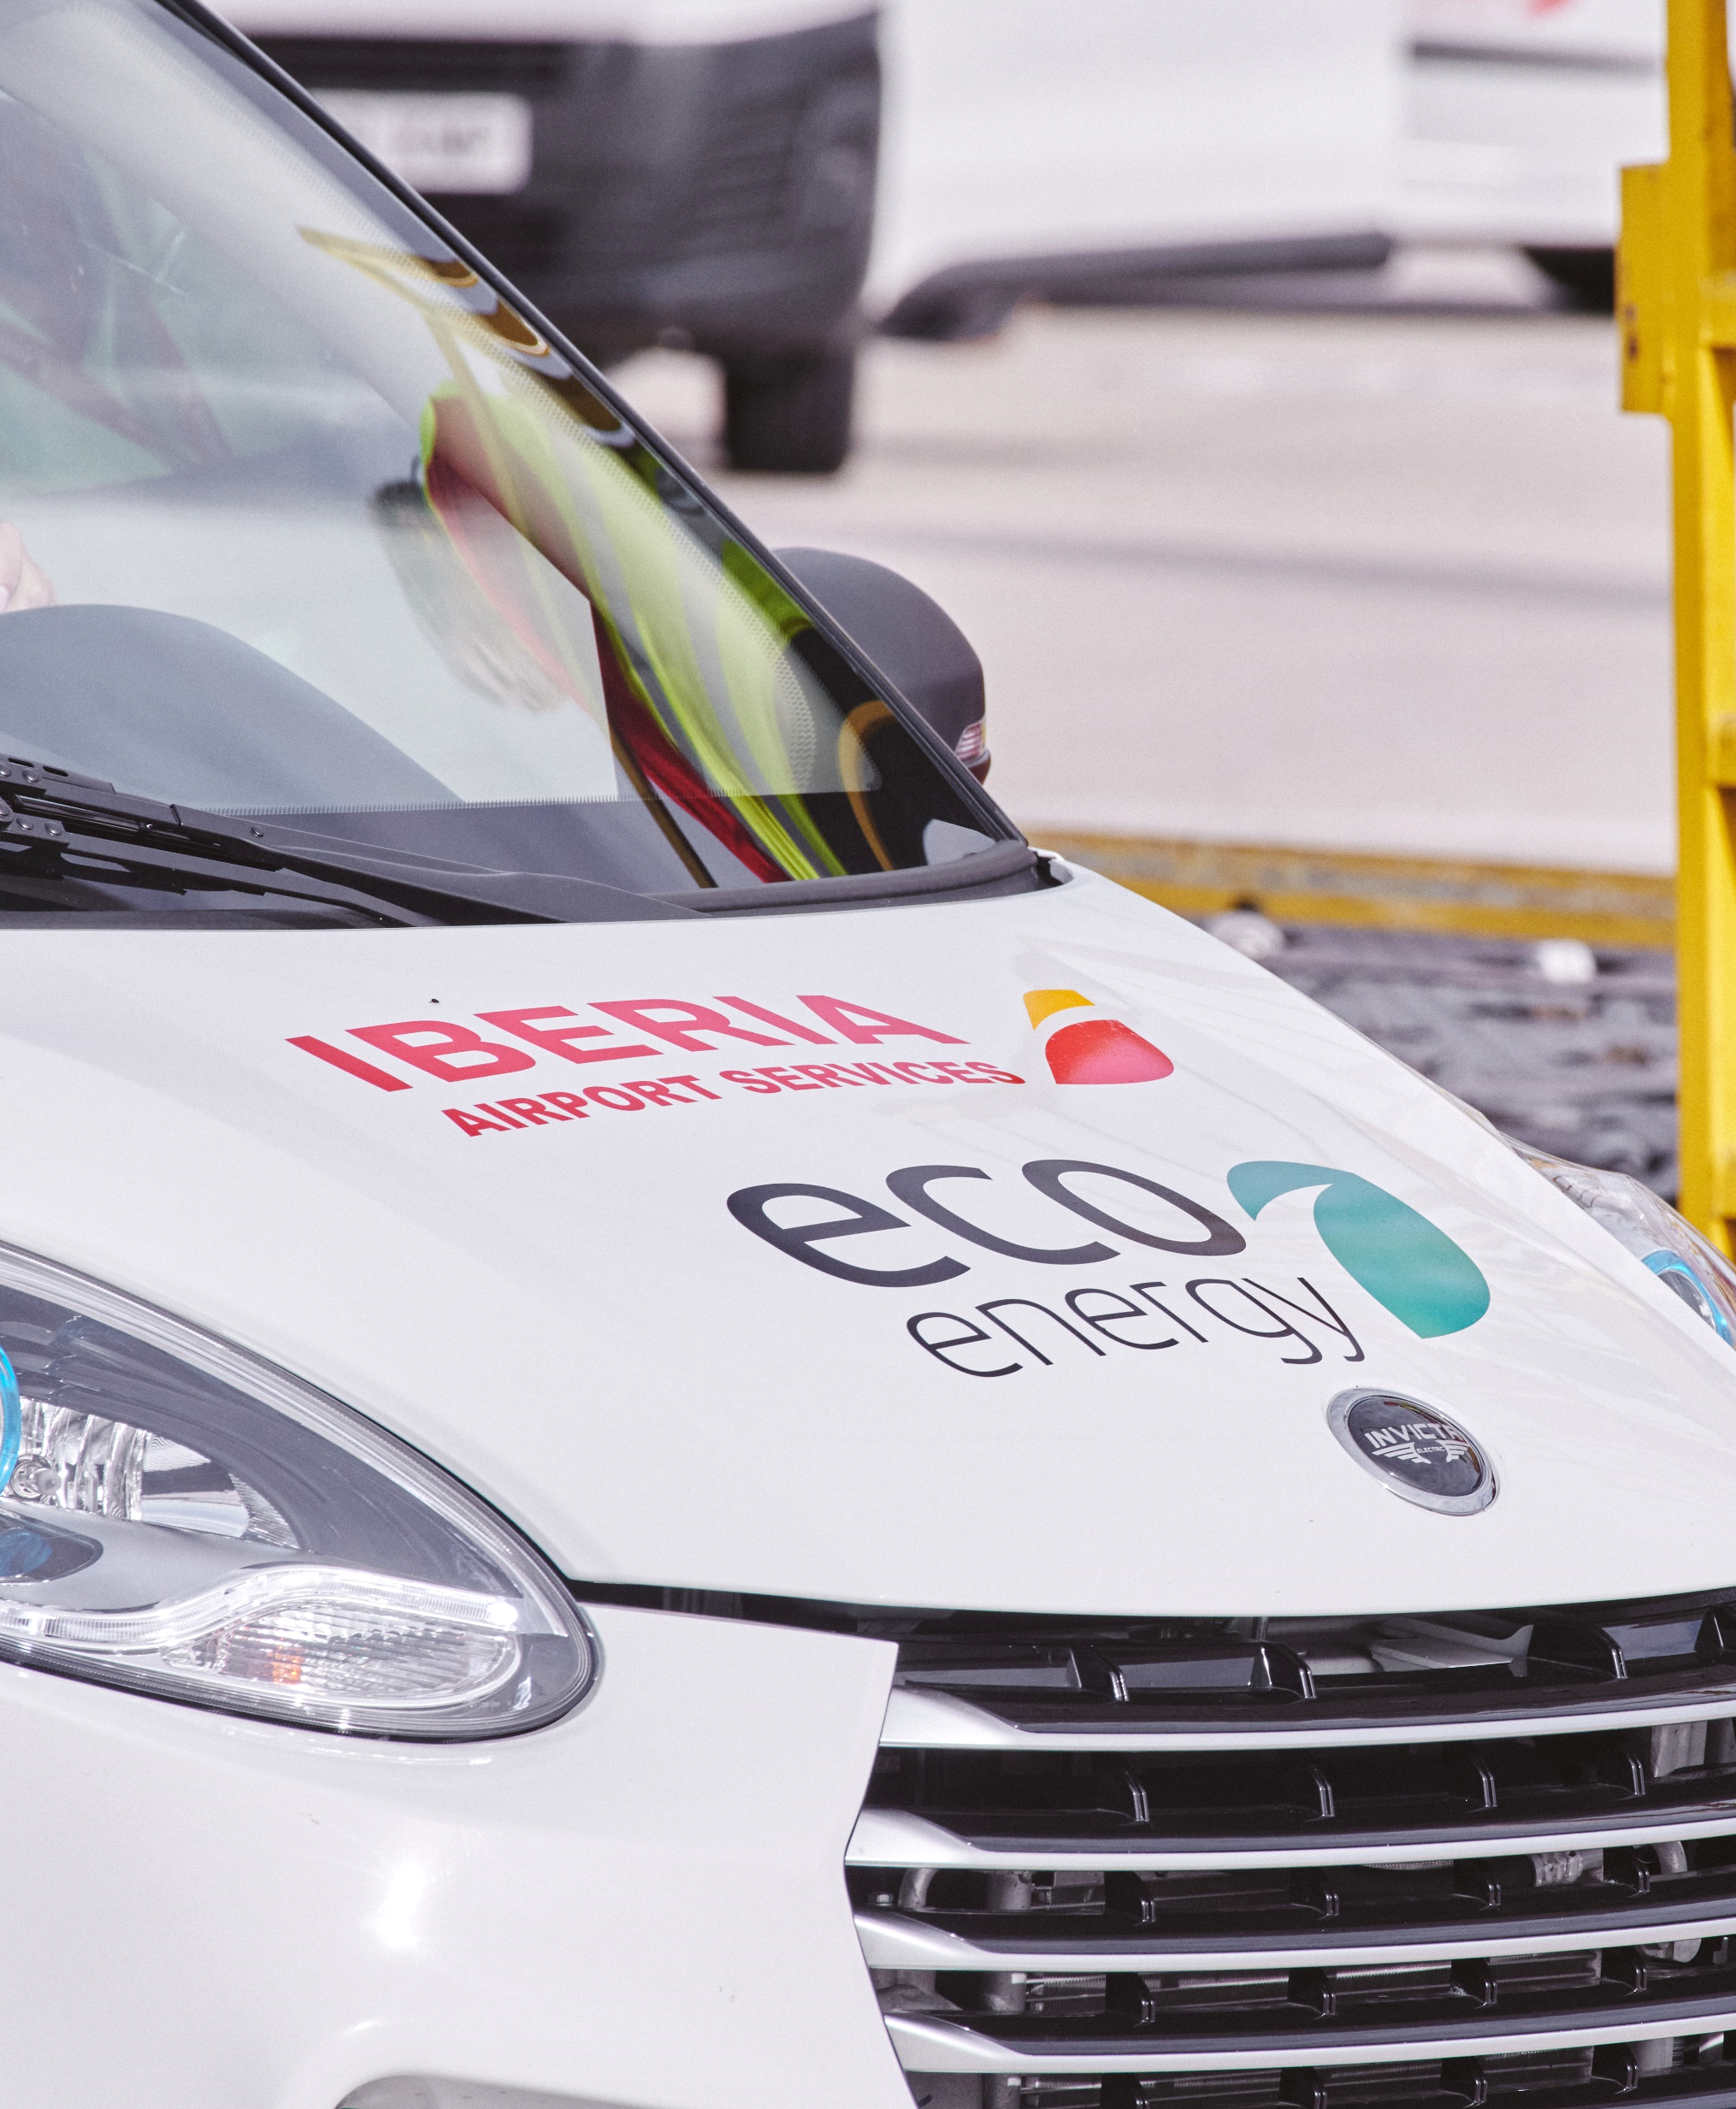
Sustainability plan
2023 – 2030
The efficiency of our GSE fleet is a priority
In the next 7 years we will incorporate electric ground support equipment (GSE) in the 80% of our fleet and we will be zero carbon by 2025, with a 100% sustainable GSE fleet.
80%
Electric GSE
from 2025
100%
Sustainable GSE
in 2025
100%
Aligned with AENA's Climate Action Plan and the ODS of United Nations
2. IBERIA AIRPORT SERVICES. Sustainability plan 2023 – 2030

Slide 3
Sustainability plan
2023 – 2030
It includes more than 30 initiatives about:
Sustainable fleet | Fleet electrification: conversion from thermal to electric vehicles, efficient battery management, GSE pooling, use of telemetry and geo-positioning
Energy efficiency | Ensure that all energy supplied for our activity comes from renewable energy
Compensation | Establishment of different carbon footprint offsetting programs
Energy projects | Set of projects focued on the development of different sustainable energy sources: HVO and H2, with the goal of reducing dependence on fossil fuels
Suppliers | Our environmental commitment is extended to our suppliers through the inclusion of environmental clauses in supply and service contracts
Textile Waste Management | Treatment of old uniformity to obtain the raw material for the renewal pieces of the uniform from a recycling process
Sustainable I+D collaboration | Active participation in top I+D collaborations: Cátedra Iberia, NetZeroCity Project, Hangar 51 start-ups platform
Social Actions | We have a program of social actions that promote social integration of disabled workers and the development of different social campaigns
Sustainable Culture Development | Awareness and training on the all environmental aspects of our activity for all our employees and collaborators
Certifications | Aligned within our Environmental and Social Management System, with an established KPIs process control and supervised by external organizations (ISO 14.001 y SR10)
3. IBERIA AIRPORT SERVICES. Sustainability plan 2023 – 2030

